Slide 1


School
Emergency Team Assignments and Duties
School Name
September/October date, 2025
Add school logo
Notes:
Facilitator conducts Welcome/Introductions.
All text in red font needs to be updated by the school/facilitator.

Slide 2

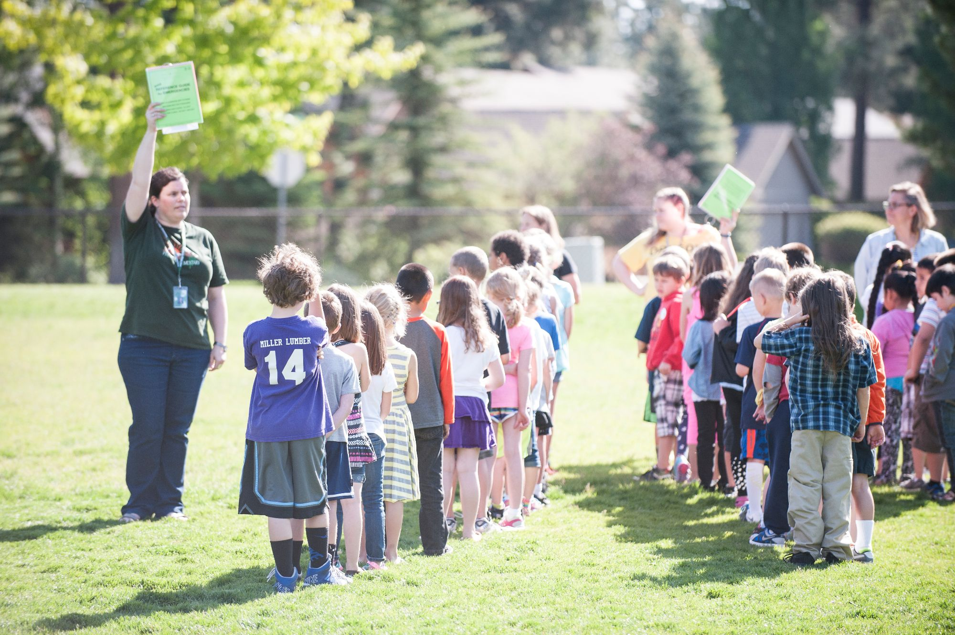
Agenda
Purpose
Accessing the Integrated Safe School Plan (ISSP)
Incident Command System
Emergency Teams
ShakeOut Exercise Reminders
Additional Resources
Questions
Emergency Drills/ISSP School Contact
Notes:
Facilitator reviews/allows staff to review slide.

Slide 3
Purpose
Provide an overview of key ISSP components:
Emergency View of the ISSP
Incident Command Team
Emergency teams, roles and locations
Off-site locations
Goals and data summary
Ensure that all staff are aware of their emergency team assignment and duties for the year
Support the school’s preparation for full-scale exercises, such as the Great CA ShakeOut, which require full emergency team activation
Satisfy the required, yearly ISSP and emergency roles training
Notes:
Facilitator reviews/allows staff to review slide.
Facilitator states:
This training is called the School Emergency Team Assignments and Duties. The ISSP holds this information for our school and thus you will notice many references to the ISSP.
Additionally, as stated in bullet three, this training satisfies the annual ISSP overview/training.

Slide 4

Accessing the ISSP
Access our school’s ISSP at issp.lausd.net (with your active LAUSD Single Sign-On)
Access our school’s ISSP print copy in the Main Office, emergency bin, and School Emergency Response Box
Notes:
- Facilitator states that online ISSP has 2 views: Planning and Emergency Views.
- Facilitator demonstrates accessing planning and emergency views (on “School Details” screen, Current ISSP section, then select “Planning View” or “Emergency View” button; to go back click on the “Back to School Details” blue button on the upper left).
Background for facilitator/not necessary to share:
- To get access for itinerants/any school staff who do not have access to their school’s online ISSP, contact OEM at oem@lausd.net or 213-241-3889.

Slide 5

Accessing the ISSP
Downloading/Printing ISSP (demonstration)
School Site Council/School Safety Planning Committee (demonstration)
ISSP Public Meeting
Notes:
Facilitator downloads current ISSP (by clicking on the “Download” button in Current ISSP section of “School Details” screen, then clicking on the first document, “ISSP…”).
Facilitator states that staff can print a copy, but that it will be updated/changed throughout the year.
Facilitator states that each school has a unique ISSP based on its needs and resources and one which is annually updated through online entries/updates. At the school level, the update process is led by the School Safety Planning Committee or School Site Council, which is identified in the print plan, as well as online ISSP, Step 1, Required Team Members and Suggested Team Members). The District also annually updates the standardized language in the ISSP.
Facilitator accesses Step 1 to display School Safety Planning Committee or School Site Council membership (Access Current ISSP, Planning View, Step 1, Required Team Members and then Suggested Team Members.) The next slide also displays our required committee members.
At the annual ISSP public meeting (which all of you can/were invited to attend), the ISSP is shared in more depth with opportunity for public comment. Per Ed Code, our school notifies local officials, representative of the local school employee organization; representative of each parent organization at the school site, including the parent teacher association and parent teacher clubs; representative of each teacher organization at the school site; representative of the student body government; and all persons who have indicated they want to be notified of the public meeting. The District will fulfill the requirement on behalf of all schools of notifying the local mayor.

Slide 6
School Site Council Required Team Members (SHOW IF SSC developed the ISSP)
Role | Member (Fill in names)
Principal/Designee
Non-Teacher School Personnel
Teacher
Teacher
Teacher
Parent (of an attending student)
Student (if secondary school)
LASPD or Local Jurisdictional Agency
Notes:
Facilitator allows participants to review slide.
Facilitator mentions that in addition to these committee members, their school has other suggested members including…(school completes).

Slide 7
School Safety Planning Committee Required Team Members (SHOW IF SSPC developed the ISSP)
Role | Member (Fill in names)
Principal/Designee
UTLA Representative
Classified Representative
Student (if secondary school)
Parent (of an attending student)
LASPD or Local Jurisdictional Agency
Notes:
Facilitator allows participants to review slide.
Facilitator mentions that in addition to these committee members, their school has other suggested members including…(school completes).

Slide 8

Accessing the ISSP
Search feature (demonstration)
Quick Reference Guide (demonstration)
Notes:
Facilitator:
- Demonstrates use of Search feature- from any view and screen, searches, such as, for someone’s name, to see all emergency roles assigned to them; searches for “lockdown” (to see District protocol) and/or for any other topic of interest. (Search field is on the upper right of every screen/view.)
-Downloads Quick Reference Guide (QRG)- states that like the Emergency View, the QRG has some of most critical information to support emergencies; this includes:
Incident Command Team
Emergency contacts
Emergency teams
Maps/plans
- States that the QRG should be reviewed by all employees (QRG should have been previously distributed to all staff); teachers may want to file with classroom emergency folder.
-Demonstrates how to access QRG: from “Current Integrated Safe School Plan” section on the School Details screen, clicks “Download” button; 3 or 4 documents will download including the QRG. (The fourth document, Tsunami Annex, only downloads for schools in the tsunami zone.)
-Displays the school’s QRG (if time was not previously provided for staff to review).

Slide 9
Accessing the ISSP
Emergency View
Emergency View, School Emergency Teams tab (demonstration)
Incident Command Team (management organization for the school’s response to an emergency)
School Site Crisis Team (provides psychological counseling for students and staff)
Emergency Contacts (phone numbers for key staff for after-hours contact)
Team Assignments (also in Planning View, Step 4)
Includes all other emergency teams and their responsibilities, meeting locations and composition
Resources feature includes more detailed descriptions: Emergency Team Duties and Supply Lists
Notes:
Facilitator:
- Demonstrates how to access Emergency View (on School Details screen, Current ISSP section, selects Emergency View); shows four tabs (School Emergency Teams, Emergency Functions, Threats and Hazards and Floor Plans and Maps) and briefly explores each.
-Accesses School Emergency Teams tab to briefly review the following:
Incident Command Team (points out Incident Commander and its backup, Search and Rescue, Triage and Assembly Area roles and any others)
School Site Crisis Team (reads description in table); states that these roles are the same as those listed in IC team chart except Psychological First Aid which is not on IC chart.
-Points out that there are Emergency Contacts to reach some key staff after hours for emergencies.
-Accesses/expands Team Assignments, for staff to view list of teams.
-Accesses “Resources” feature (from any view or screen) to display and skim Emergency Team Duties and Supply Lists under “Forms and Key References.”

Slide 10
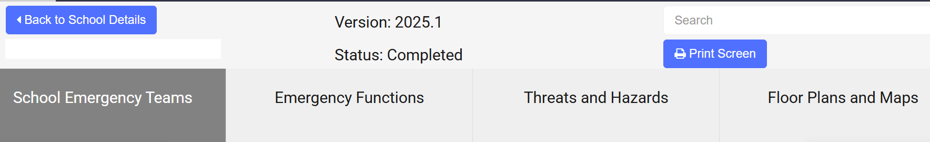
Accessing the ISSP
Emergency View
Emergency View, Emergency Functions tab (demonstration)
Emergency View, Threats and Hazards tab (demonstration)
Emergency View, Floor Plans and Maps tab (demonstration)
Primary Off-site Location (demonstration)
Backup Off-site Location (demonstration)
Vicinity Map (demonstration)
Notes:
Facilitator:
-Accesses Emergency Functions tab. (If time permits, ask employees to review protocols for a few, such as, Accounting for all Persons and Relocation.)
-Accesses Threats and Hazards tab. (If time permits, ask employees to review protocols for a few, such as, Food/Water Contamination and Utility Failure.)
-Accesses Floor Plans and Maps and points out that this tab includes Primary and Backup Off-site Locations’ contact information and map (labeled “vicinity map”). States that these are used in situations which require evacuating from the school premises and relocating to an off-campus site. Stresses that maps and plans must be redacted in any ISSP version which the public may access.

Slide 11
Incident Command System
Required nationwide and used by first responders, government agencies, including LAUSD, and others to manage emergencies/disasters
Consists of five functions/sections: Command, Operations, Planning and Intelligence, Logistics, and Finance & Administration
During emergencies, Incident Commander will coordinate with municipal emergency
first responders
Notes:
Facilitator states:
- All five sections of the ICS report to the Incident Commander, who is the principal (change if school’s IC is not the principal).
- Our school emergency teams are assigned to each of these five areas.
For facilitator background (do not need to share):
ICS Incident Command Team Chart (link provides blank form to be completed for individual emergencies); for some incidents/drills, school does not need to activate all positions.
ICS Definitions for Schools- another resource which defines the ICS roles, such as, public information officer, logistics section lead, and psychological first aid/crisis.

Slide 12
Emergency Teams
Our school reviews and updates emergency team assignments as part of the yearly ISSP update process, as well as throughout the year.
This includes 11 school emergency teams, two required positions (School Emergency Response Box and Access and Functional Needs) and 3 optional positions (Transportation Support, Documentation/Communication, and Cost/Staff Accounting). (demonstration)
All co-located schools/programs, if applicable, are represented and contribute to one ISSP and one set of emergency teams.
Our school’s Quick Reference Guide (QRG) also lists team membership.
Notes:
Facilitator reads/allows staff to read slide.
For facilitator background/do not need to share:
- DACE sites with DACE/small ISSP template do not have 11 emergency teams, rather only have one.

Slide 13
Emergency Teams
Emergency Team | Description | Members | Meeting Location (Inside and Outside)
Triage | Performs triage and provides medical assistance, ensures supplies are accessible, and evacuates and stages supplies | School-specific column | School-specific column (2 locations for each)
School Site Crisis | Provides psychological/emotional support for students and staff
Search and Rescue | Performs search and rescue operations
Access and Functional Needs Position | Ensures the safety of students and adults with access and functional needs during drills and emergencies
Security/ Utilities | Ensures school site security and performs short-term repairs and shutoff of utilities
Notes:
Facilitator asks staff to read this and next two slides for familiarity with the emergency teams and as background for a group activity.
For group activity details, facilitator accesses handout titled, School Emergency Team Assignments and Duties Activity.
Background for facilitator/not necessary to share:
- Emergency team inside and outside meeting locations should be away from hazards, near evacuation area and emergency bin.
- Under most common circumstances (including fire and earthquakes), emergency teams, if activated, will meet at their outdoor location. If not stated in the District’s protocol, emergency teams will be activated based on the nature of the incident at the discretion of the Incident Commander.

Slide 14
Emergency Teams
Emergency Team | Description | Members | Meeting Location-Inside and Outside
Fire Suppression/ HazMat | Extinguishes small fires and evaluates chemical spills | School-specific column | School-specific column (2 locations for each)
Assembly Area | Ensures safe evacuation and accounting for all students, staff, and visitors
Request/Reunion Gate | Processes requests for student pick-up and reunites students and parents at Reunion Gate
Supply/Equipment | Ensures adequate equipment and supplies
Hygiene | Provides all necessary sanitation-related support
Notes:
See previous slide.

Slide 15
Emergency Teams
Emergency Team | Description | Members (Primary and Backup) | Meeting Location-Inside and Outside
Transportation Support Position (optional) | Coordinates transportation assets and plans, such as, for an off-site relocation from the school | School-specific column | School-specific column (2 locations for each)
Documentation/ Communication Position (optional) | Maintains emergency log, analyzes situation, and updates Incident Commander
Cost/Staff Accounting Position (optional) | Maintains accurate emergency time records for all site-based and itinerant employees
Manager of School Emergency Response Box | Evacuates the School Emergency Response Box(es) during emergencies and drills and ensures that information filed in the box is up to date
Notes:
Facilitator states, as previously mentioned, the QRG also lists the team members and should be reviewed and accessible.

Slide 16
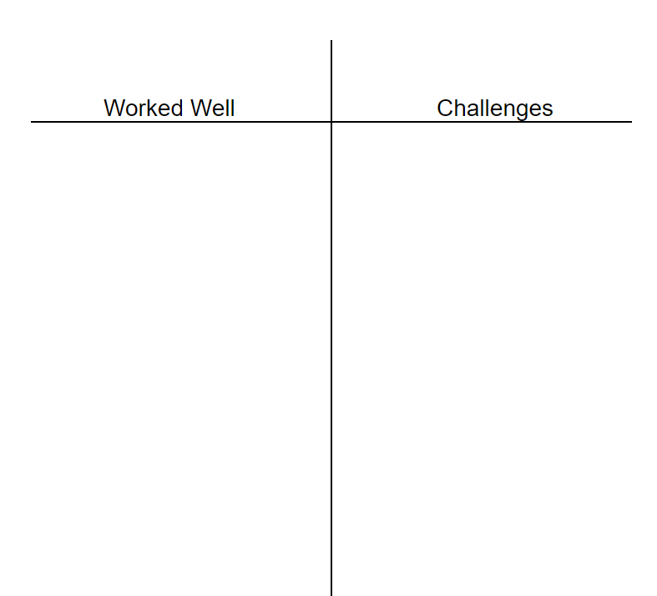
School Emergency Team Assignments and Duties Activity
Notes:
Facilitator uses handout, School Emergency Team Assignments and Duties Activity, to lead participants, grouped by assigned emergency team through a seven-to-ten-minute activity. Staff with multiple emergency team assignments can select the one with which they are least familiar.

Slide 17
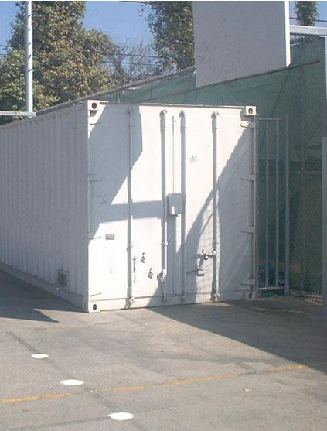

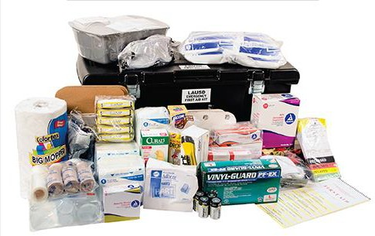
Emergency Teams
Emergency Supplies and Equipment
We have the required quantity of food, water, and other supplies (REF-5451 School Site Emergency/Disaster Supplies); each of our emergency teams also require specific supplies and/or equipment: Emergency Team Duties and Supply Lists which we have in our emergency bin.
Notes:
Facilitator states:
-As some of you noted, the Supply/Equipment Team ensures adequate supplies/equipment are available.
-Emergency supplies/equipment are stored in an emergency bin located near our assembly area which for our school is (specifies where).
-Our school inventories the emergency bin twice a year.
- Team leads should review the Emergency Team Duties and Supply Lists to ensure supplies are available.

Slide 18
Emergency Teams
All school staff should be familiar with the following: | Location
Emergency supplies/bin (Step 4, Site Specific Considerations or QRG) | School completes rest of column
Automatic External Defibrillator (AED) Location(s)
Assembly area (Emergency View, School Emergency Teams tab, Team Assignments, Assembly Area Team, Meeting Location [inside and outside] or Planning View, Step 4, Team Assignments, Assembly Area Team, Meeting Location [Inside/Outside])
Primary and backup off-site locations (Emergency View, Floor Plans and Maps tab, Primary [and Backup] Off-site Location or Planning View, Step 4, Floor Plans and Maps, Primary [and Backup] Off-site Location)
Evacuation routes | Map should be accessible in all classrooms, offices and common areas
Incident Command Team
Notes:
Facilitator provides school-specific details for each item listed (also specified in Step 4, Planning or Emergency View as specified above).
For facilitator background/do not need to share:
- Incident Command Team meets near the Assembly Area team.

Slide 19
Emergency Teams
General Protocols
All | React in a calm, decisive, and reassuring manner. May need to serve on more than one emergency team/role; prioritize search and rescue, triage and fire suppression roles before others.
All Teams/ Classroom Teachers | Walk the evacuation routes, noting any potential hazards or challenges along the way that may impact anyone who may need additional support during an evacuation. Consider what damages to the route or debris could make evacuation difficult.
Classroom Teachers | Make arrangements with a nearby teacher or the Assembly Area Team for someone to supervise your class, should the need arise. Tell your students who will be in charge of them while you are gone so that they know an adult is caring for them.
Notes:
Facilitator may ask staff to read slide particularly sections most relevant to their role(s). Provides opportunity to share.

Slide 20
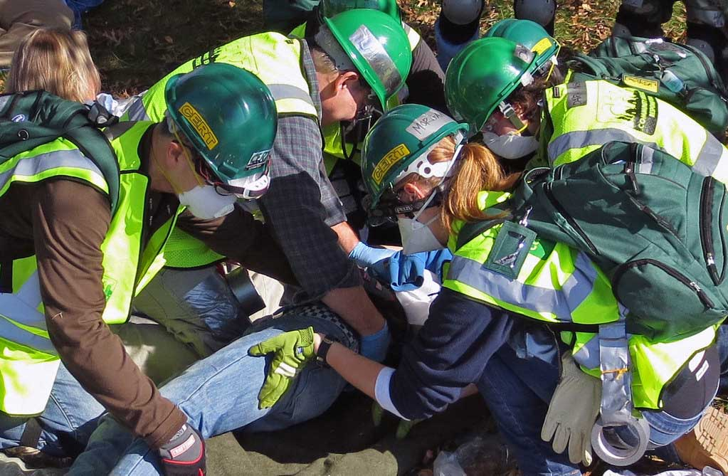
Emergency Teams
Other Resources
Additional emergency team training resources for staff include:
MyPLN STEPS courses
STEPS
lausd.org/myPLN
Community Emergency Response Team
lausd.org/cert
Notes:
Facilitator states:
MyPLN STEPS courses include Search and Rescue (STEPS 214) and Triage Team (First Aid) (STEPS 213) trainings, as well as for specific disasters (STEPS 200- fire; STEPS 202- earthquake; STEPS 203- lockdown, STEPS 204-Shelter in Place, STEPS 205-Radiological Incident).
The Community Emergency Response Team (CERT) program educates people about disaster preparedness for hazards that may impact their area and trains them in basic disaster response skills, such as fire safety, light search and rescue, team organization, and disaster medical operations.

Slide 21
Great CA ShakeOut Exercise Reminders
ShakeOut held yearly, third Thursday in October (October 16, 2025)
Practice with all teams activated, all appropriate stations, and all roles in place
All co-located schools/programs collaborate and participate in a single exercise
After Drop, Cover and Hold On, conduct complete and timely evacuation of all buildings to one, designated assembly area (for all schools/programs on site)
Designate areas for triage, toilets, morgue, media, etc.
Full details available: REF-5803 Emergency Procedures, Drills, and Districtwide Emergency Exercises
Notes:
Facilitator asks staff to read slide and consider how their specific emergency role(s) will support the school during the full-scale exercise. Staff can share their experiences in past ShakeOut’s and/or their commitments/focus for this year.

Slide 22

Additional Resources
Classroom Emergency Quick Guide
Notes:
Facilitator states:
-The Emergency Classroom Quick Guide is used by staff to remind them of emergency/drill procedures.
-Guide has the same information as that which is in the ISSP.
-Guide should be visibly posted in all classrooms and common areas.
-During drills, we should be practicing use of our evacuation chair. (Facilitator delete if you do not have an evacuation chair.)
The District’s STEED program provides training to all multiple-story schools and an Evac+Chair to support those with mobility needs in evacuating. (If applicable) Ours is located …; the team which was trained included….
Background for facilitator/not necessary to share:
All schools were provided a new version of the guide in August/September 2022. Ensure updated one is in use.
For more information on evacuation chair training, access: STairway Emergency Evacuation for Disabilities
(STEED)

Slide 23
Questions?
Notes:
Facilitator answers questions.

Slide 24
Emergency Drills/ ISSP School Contact
Name
Contact information
Notes:
Facilitator provides contact information for school’s emergency drill/ISSP designee(s).

Slide 25
We appreciate your participation today and your support in ensuring our school’s preparedness.

